Slide 1
LOSOM Update Collier County Board of County Commissioners
September 14, 2021
Nicole Johnson, Director of Environmental Policy, Conservancy
James Evans, Director of Environmental Policy, SCCF
Dr. Paul Julian, Ph.D., Hydrologic Modeler, Conservancy/SCCF

Slide 2
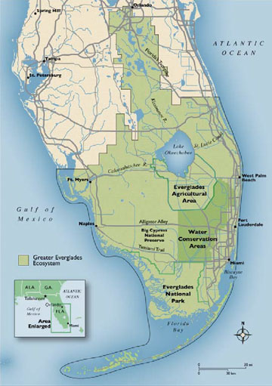
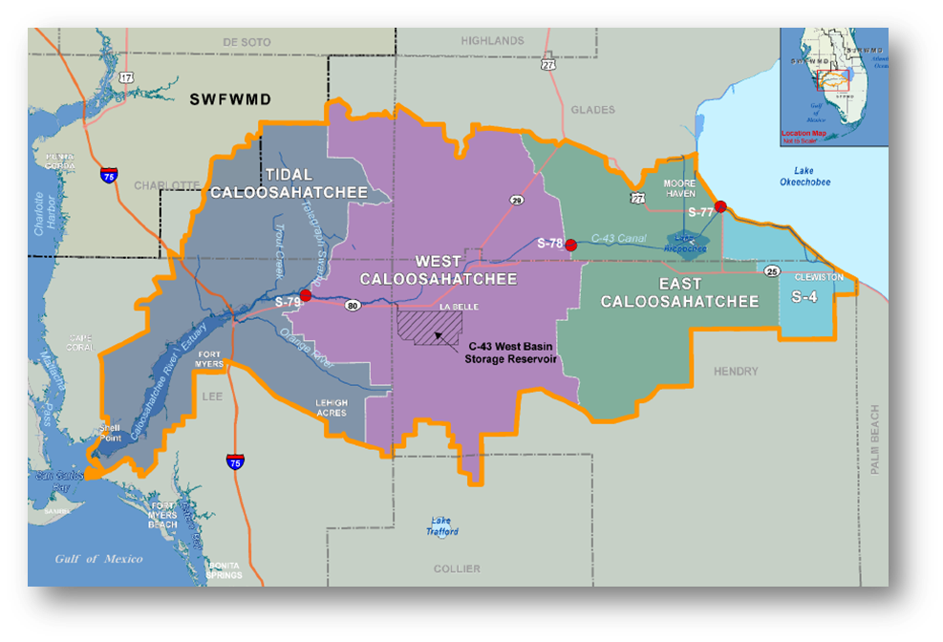
Caloosahatchee & Coastal Water Quality Affected by both Caloosahatchee Watershed
& Lake Okeechobee Discharges
Caloosahatchee Watershed >850k acres

Slide 3
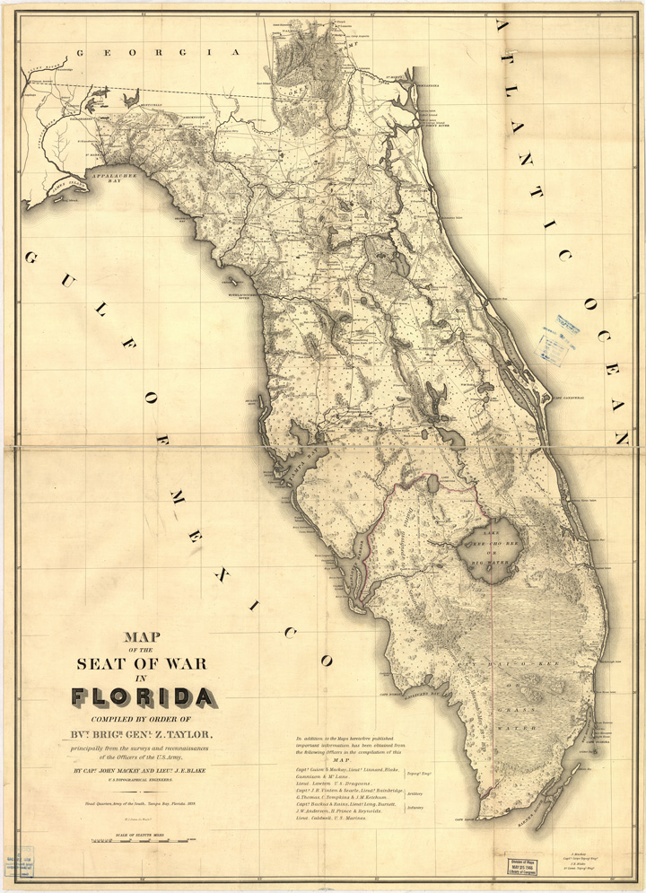
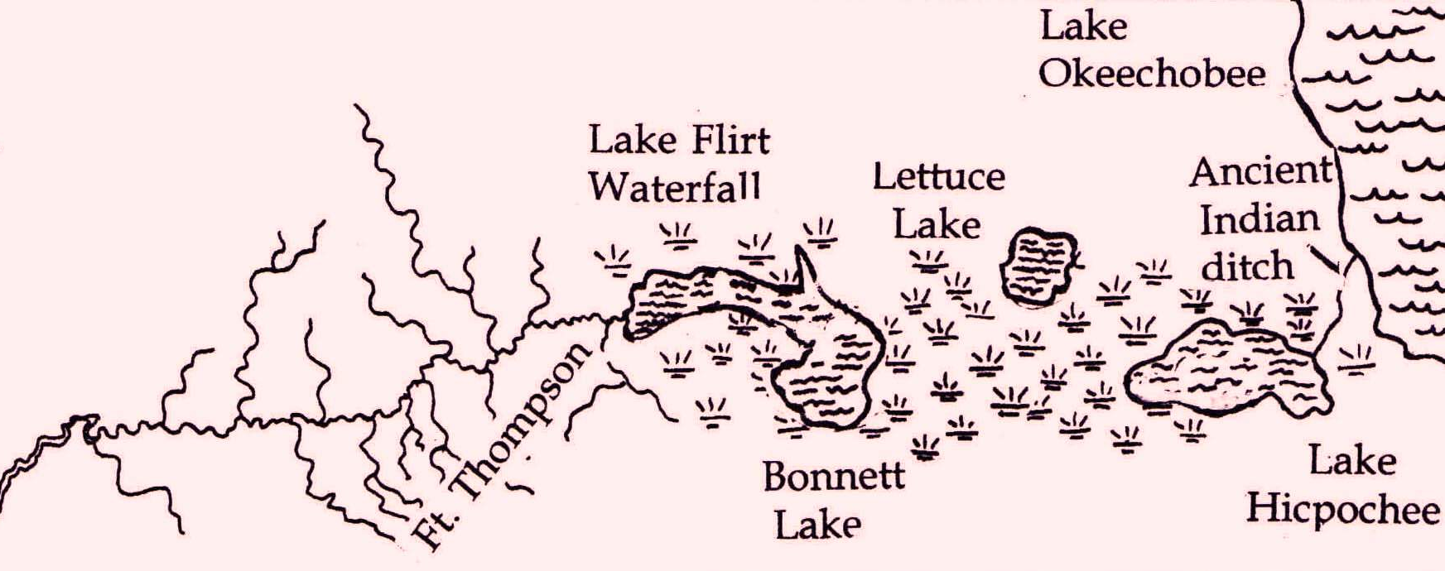
Caloosahatchee - Everglades Connection
Historically
Caloosahatchee not
Connected to Lake O
Caloosahatchee Valley of Lakes
Map

Slide 4
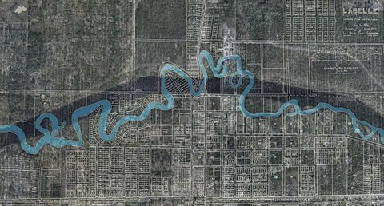

Caloosahatchee Dredged & Straightened
Circa 1920’s
To Provide Navigation and Flood Control

Slide 5
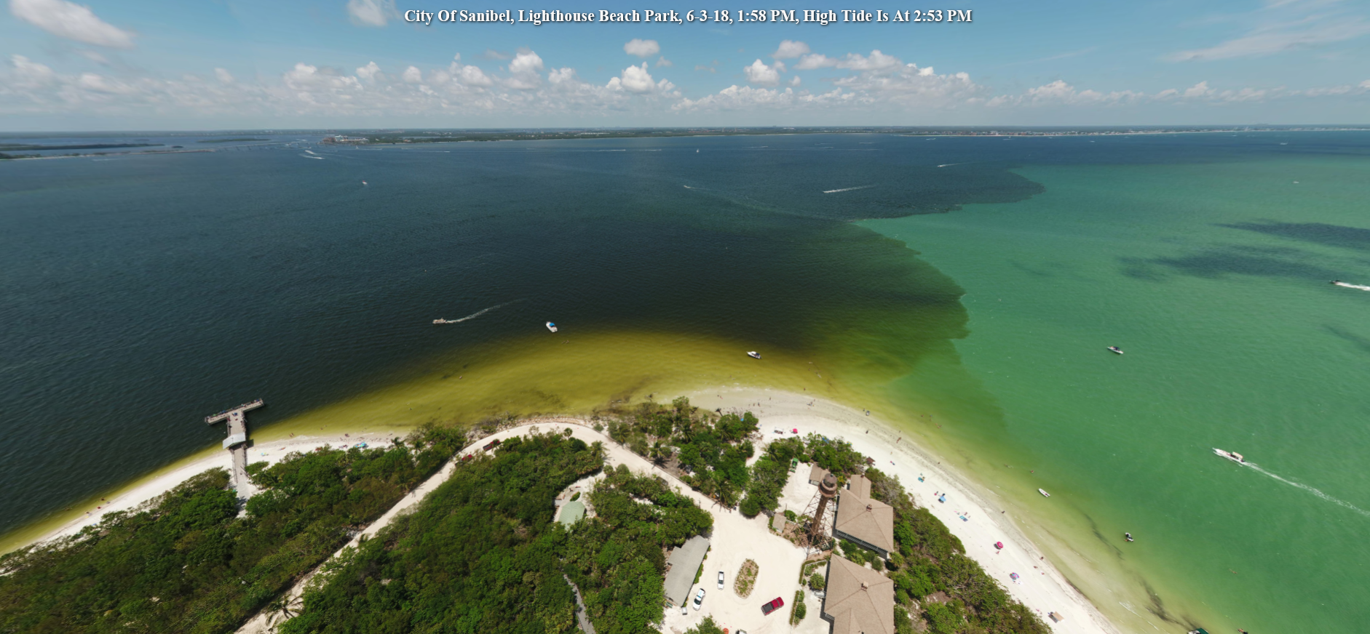
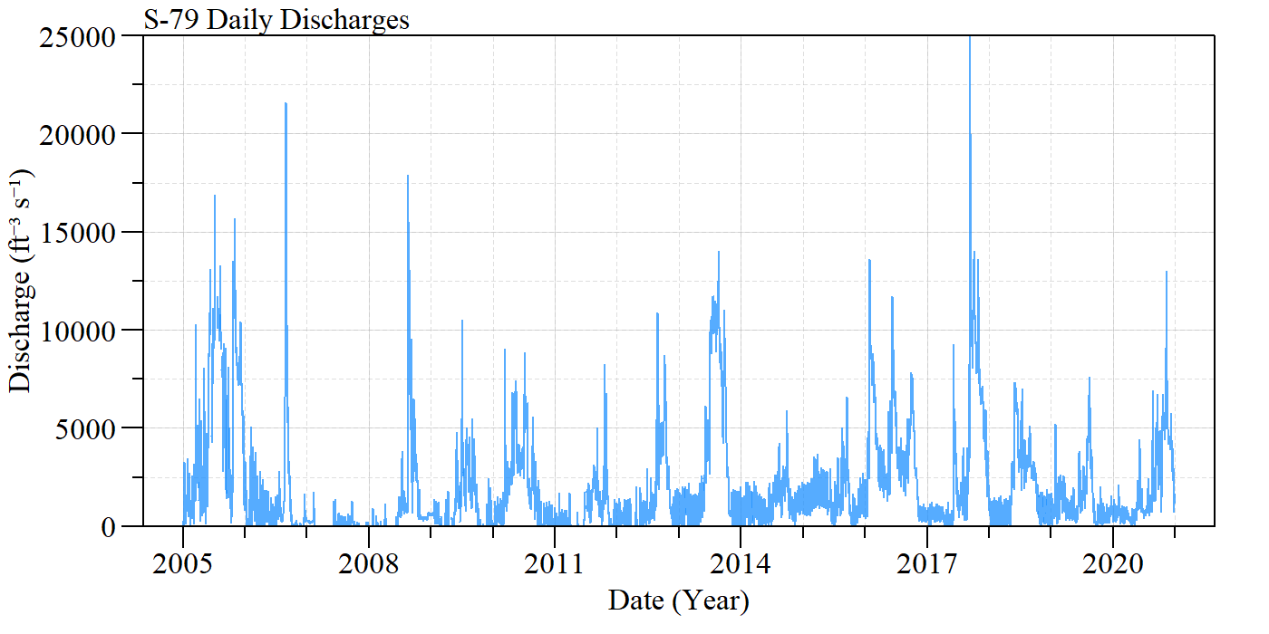
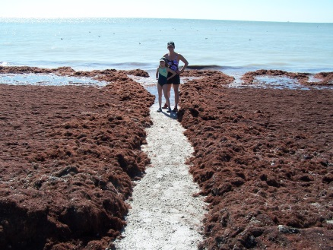
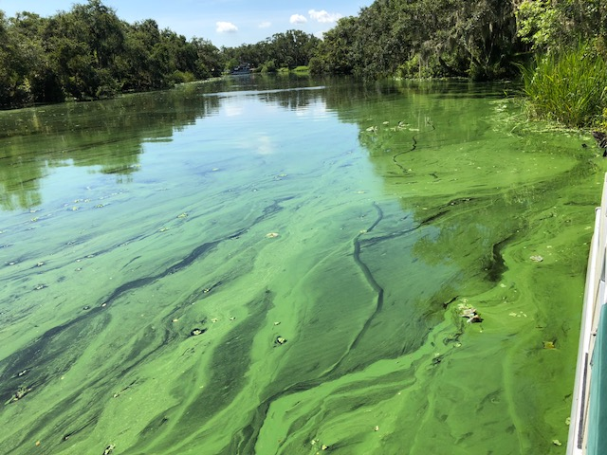
Caloosahatchee Impacted by
Water Quantity & Quality
Too Much Flow
June 3, 2018
10/25/06
7/2/18

Slide 6
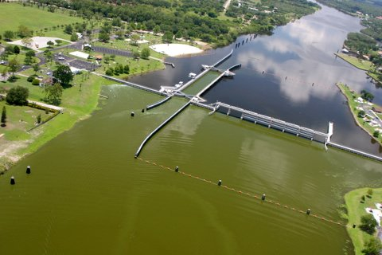
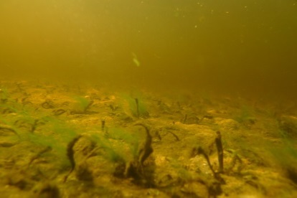
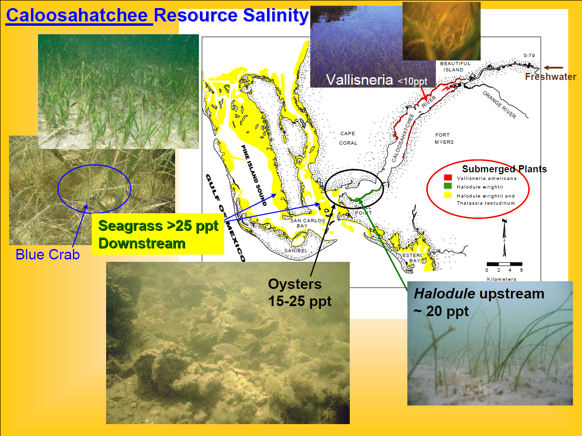
Caloosahatchee Impacted by
Water Quantity & Quality
Too Little Flow
June 2008
Photo John Cassani

Slide 7
How do Caloosahatchee discharges impact Collier County?

Slide 8
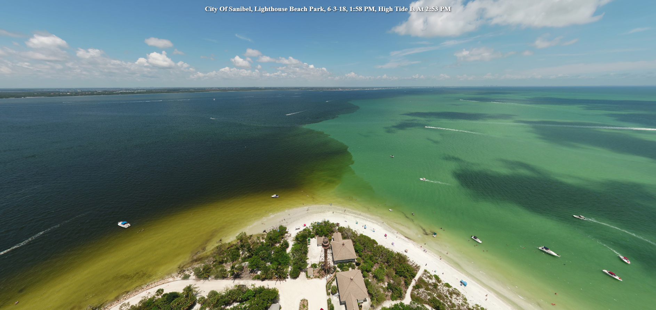
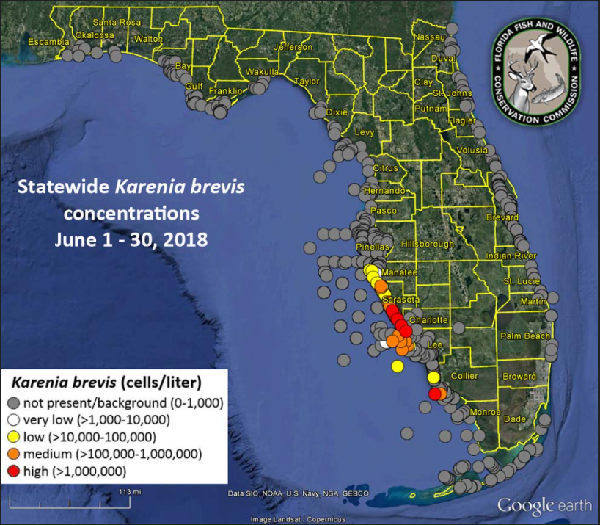
June 3, 2018

Slide 9
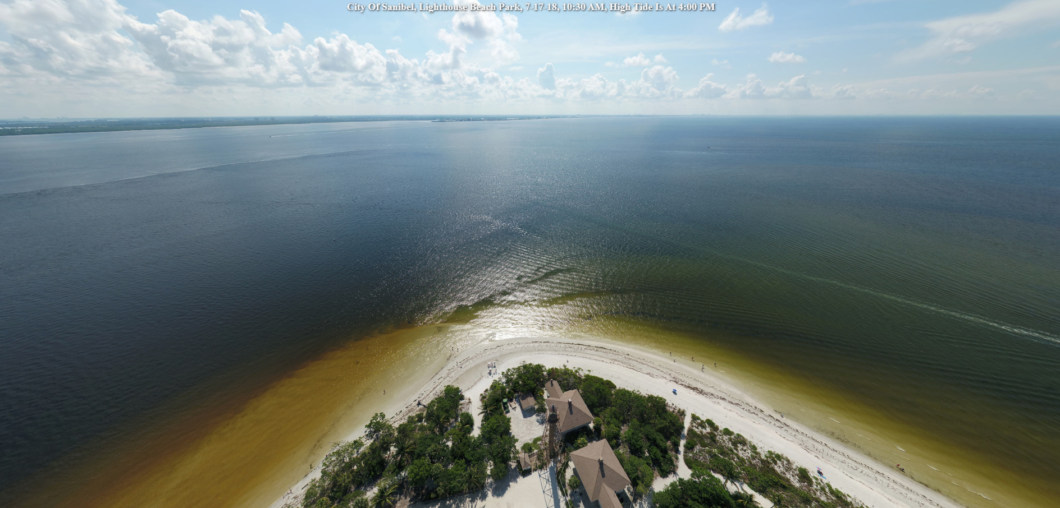
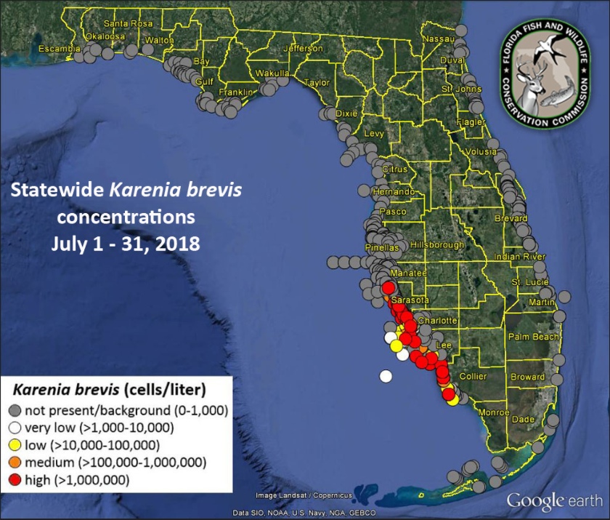
July 17, 2018

Slide 10
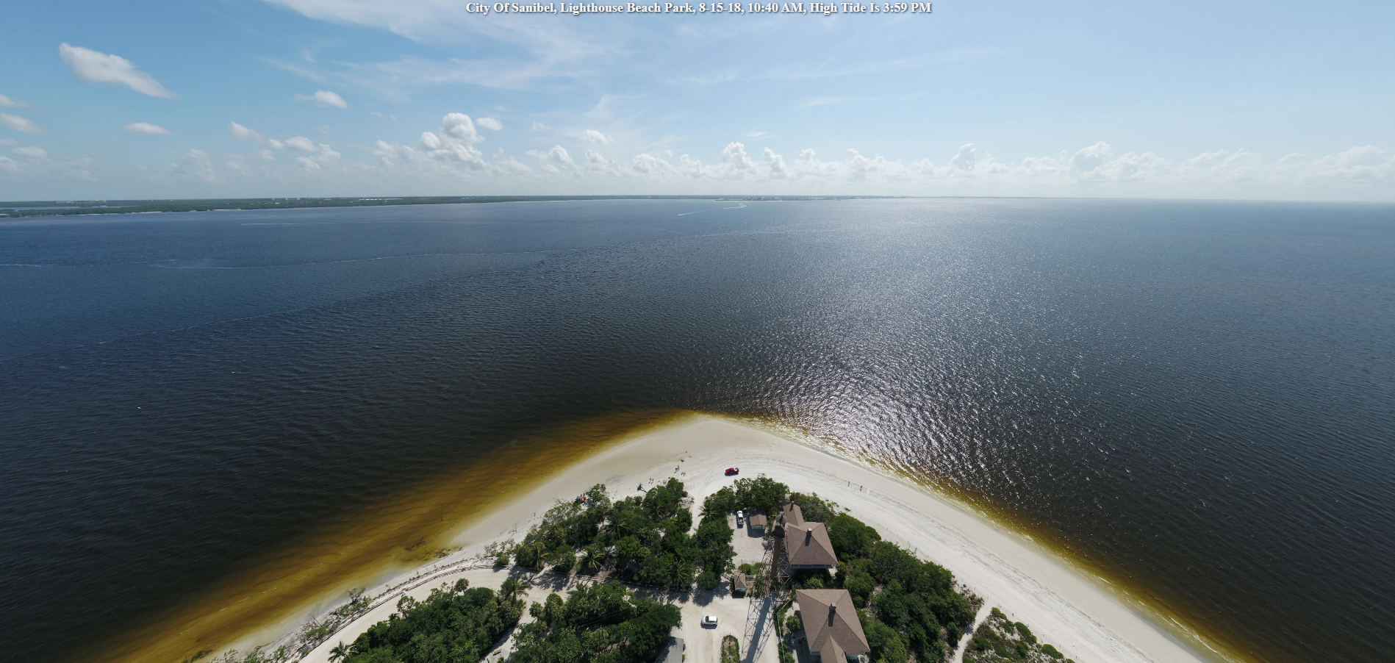
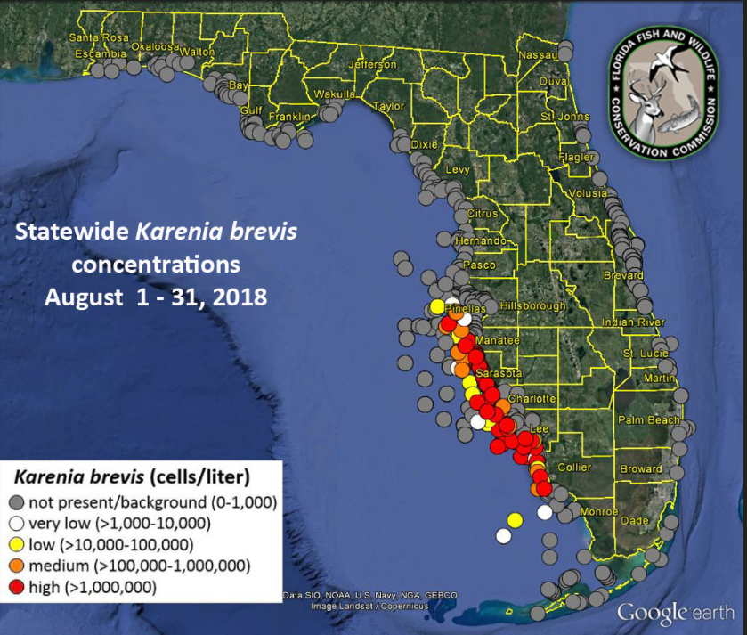
August 15, 2018

Slide 11
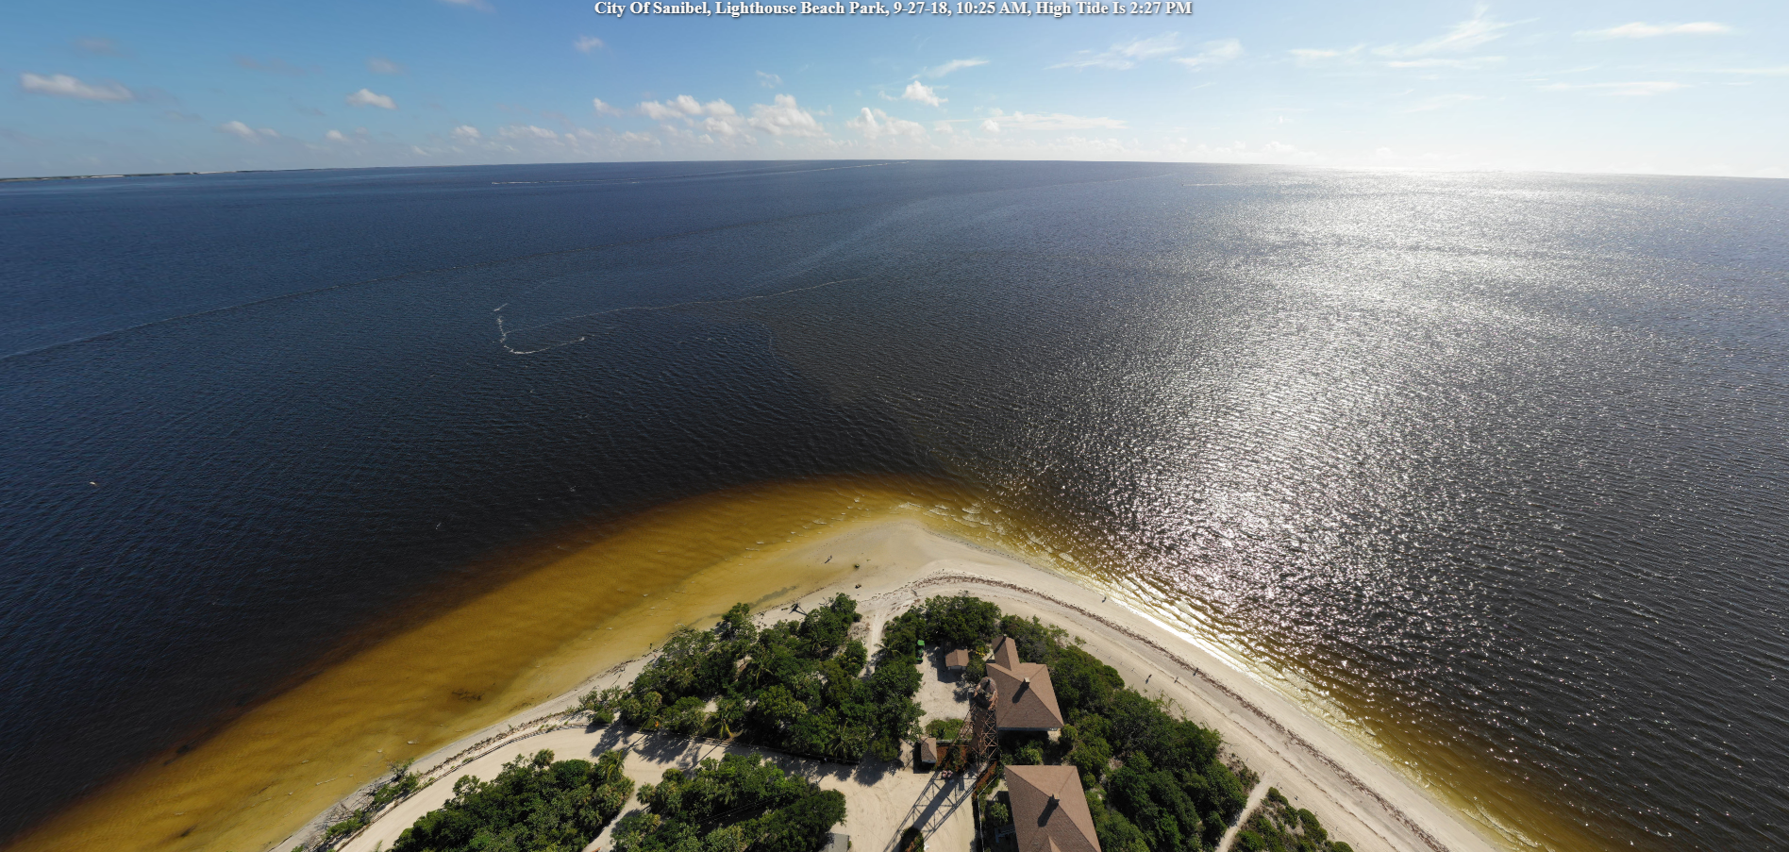
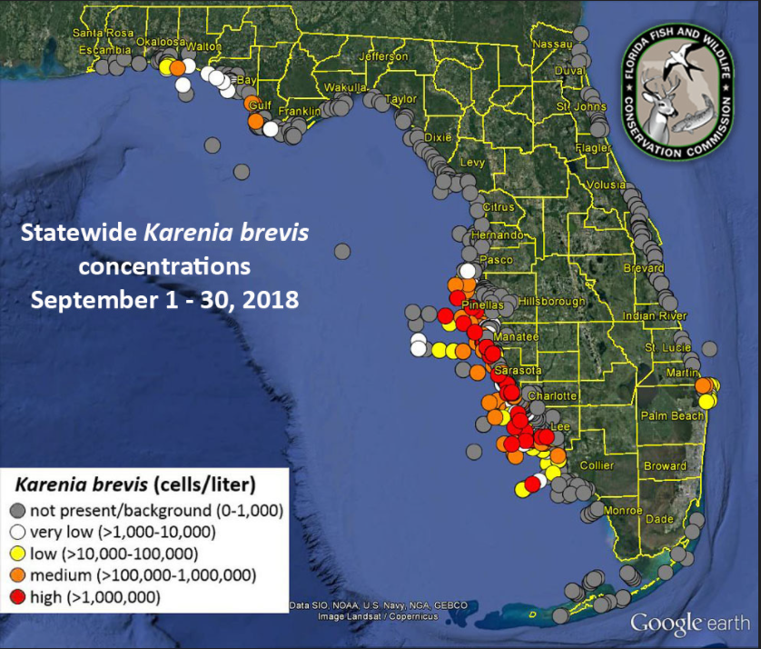
September 27, 2018

Slide 12
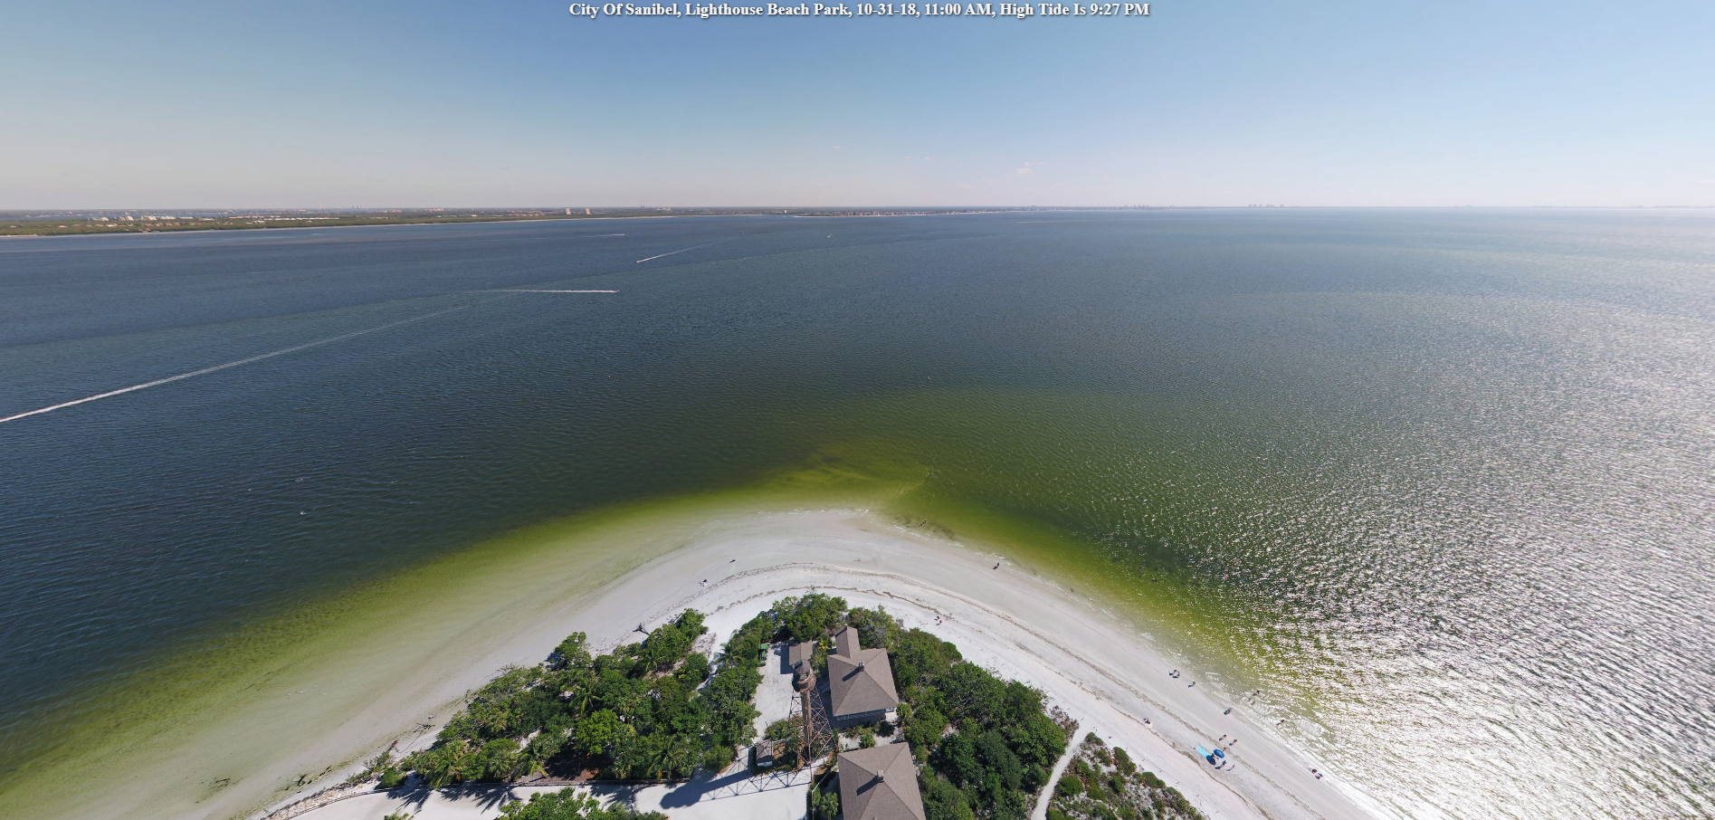
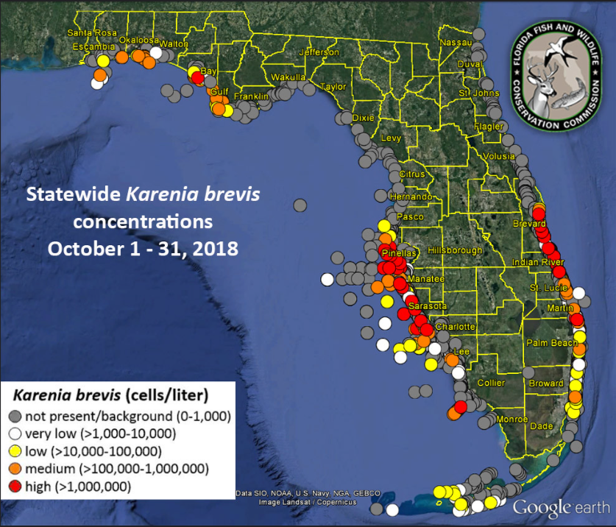
October 31, 2018

Slide 13
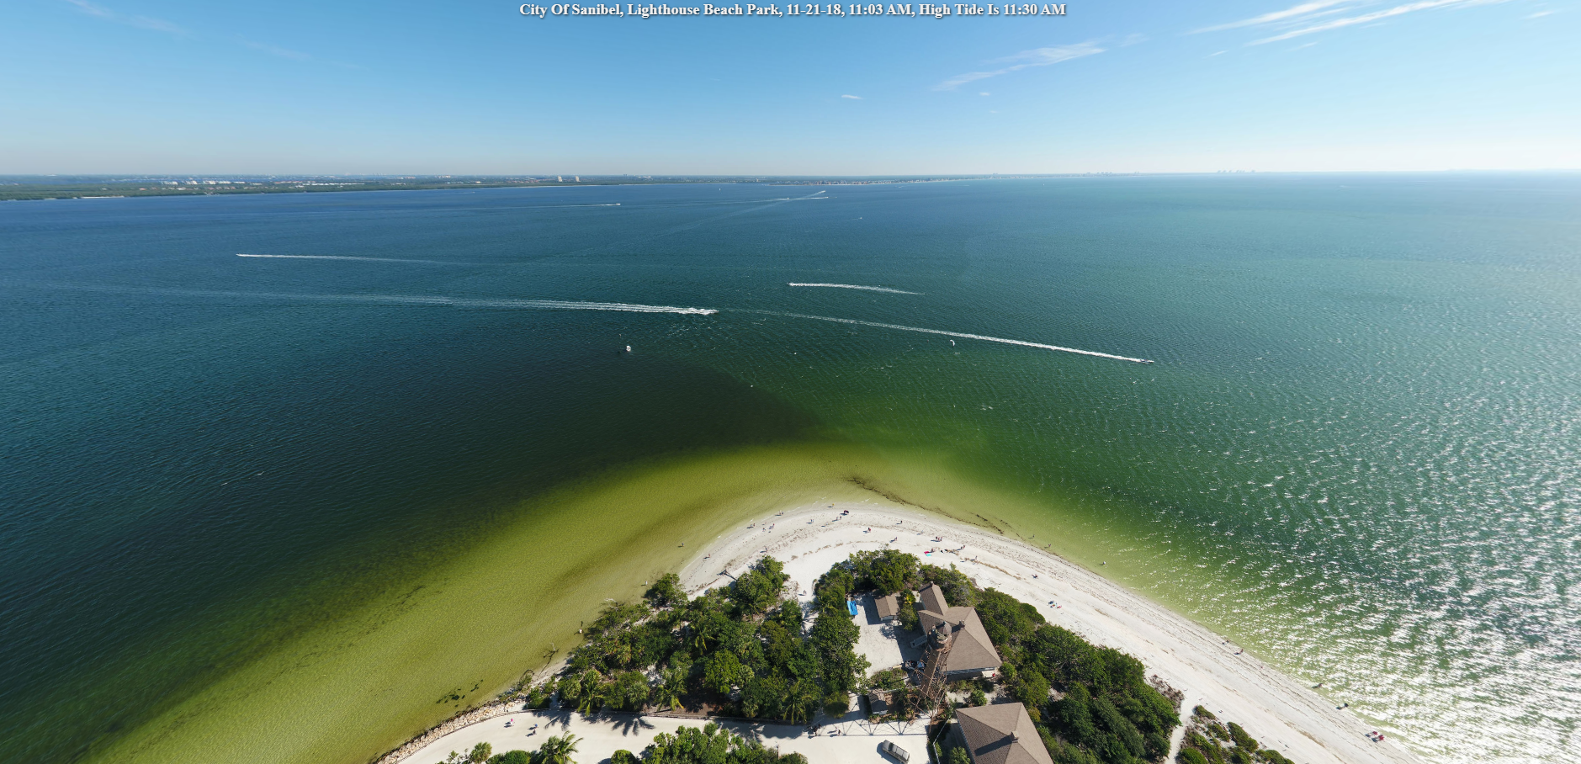
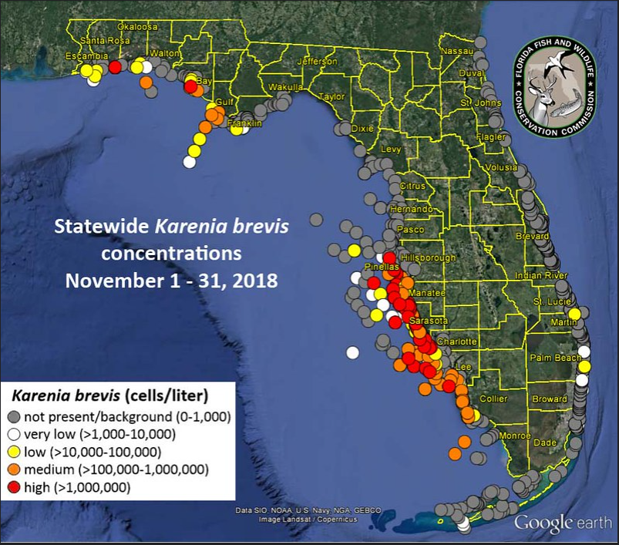
November 21, 2018

Slide 14
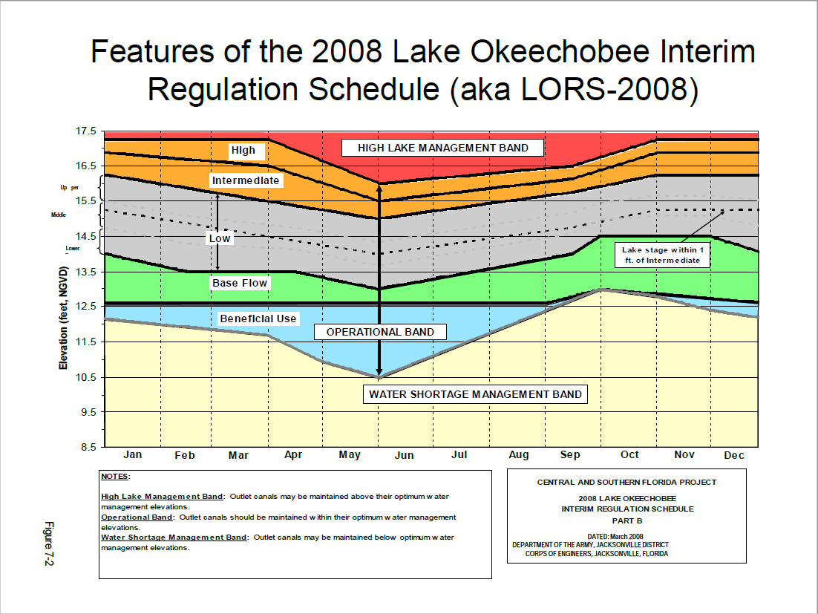
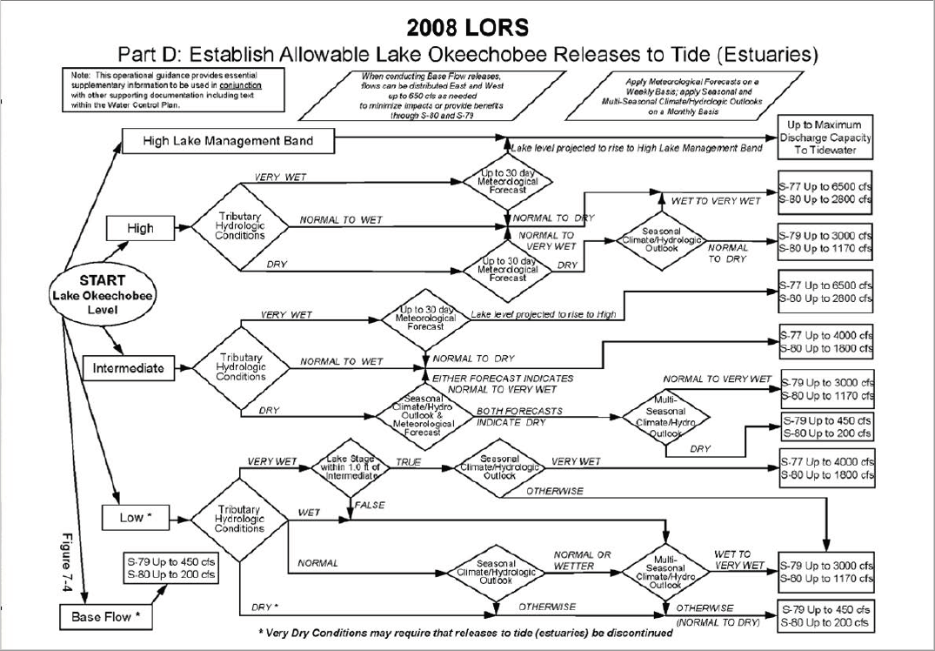
Lake Okeechobee Regulation Schedule

Slide 15
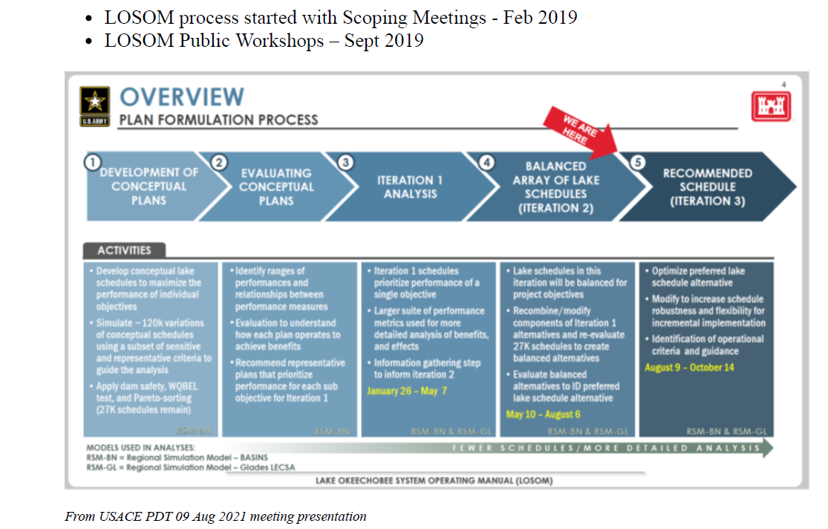
LOSOM Process & Timeline

Slide 16
Iteration 2 – Model Alternatives
From USACE PDT 19 July 2021 meeting presentation

Slide 17
Concerns with Alternative CC
Water supply & flood control constraints put pressure on the estuaries as the primary outlets for C&SF Project
Alternative CC redistributes harmful regulatory flows from the SLE to CE
Flows to CE are measured at S-77 when conditions are wet – does not take into account watershed runoff when making release decisions (flows always measured at S-80 in SLE)
Does not allow beneficial dry season flows to CE & Everglades in Zone F
Increases total regulatory flows to CE by 9%, TN & TP loading increases by 10 & 12%, respectively; reduces regulatory flows to SLE by 62% & reduces TN & TP by 62 & 63%, respectively
Only decreases lake-triggered damaging events to CE by 16% and increases stressful flows (2,100-2,600 cfs) by 58%, while St. Lucie gets 88-91% reduction in lake-triggered RECOVER damaging & stressful flow events
Caloosahatchee & south are the only outlets in Zone D – Lake O recovery periods could increase releases to CE in Zone D
Allows back flowing of water & nutrients into the lake from C-44 & EAA (C-44 backflow ~60%).

Slide 18
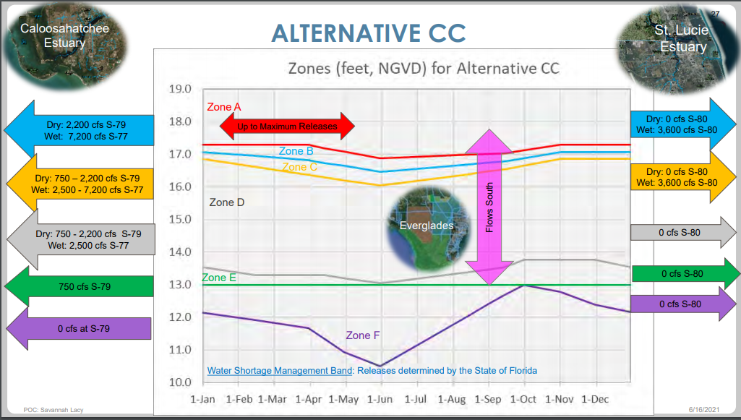
S-79 vs. S-77
*No water sent to SLE in Zone D
*Does not allow regulatory flows to the CE in Zone F

Slide 19
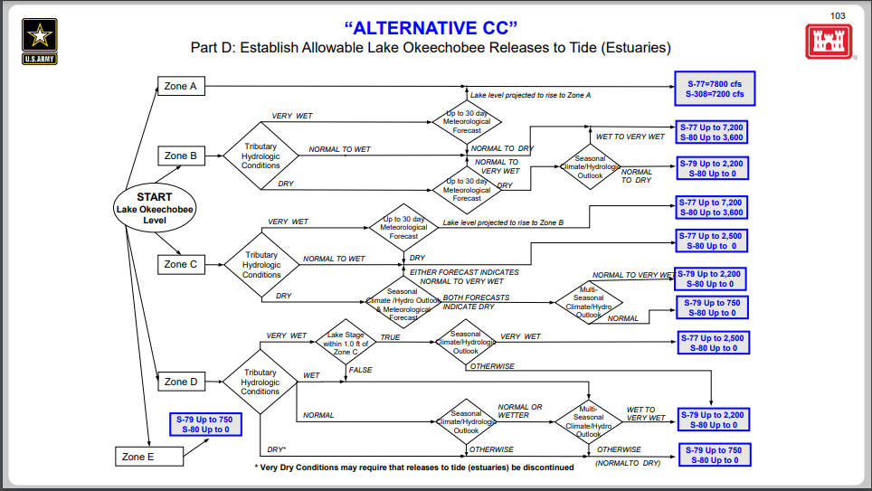
*Still measures at S-77 when conditions are wet
*Does not allow regulatory flows to the CE in Zone F

Slide 20
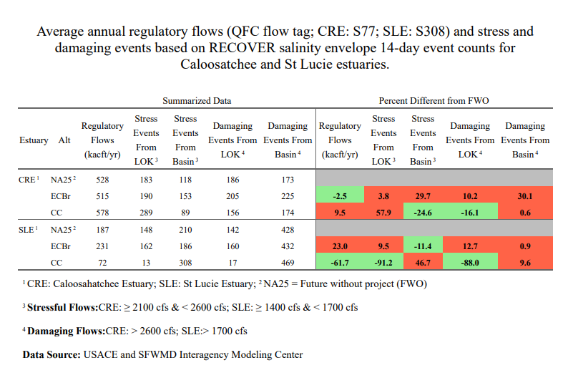

Slide 21
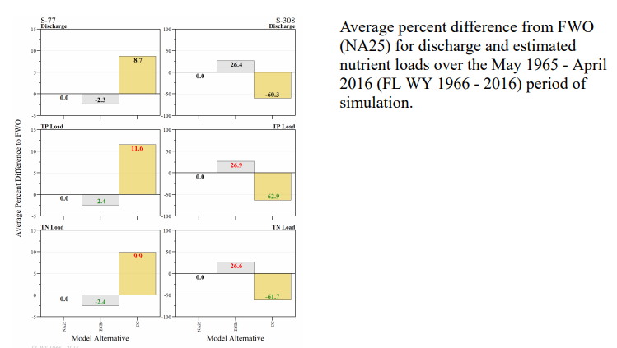
Regulatory Flows & Nutrient Loading

Slide 22
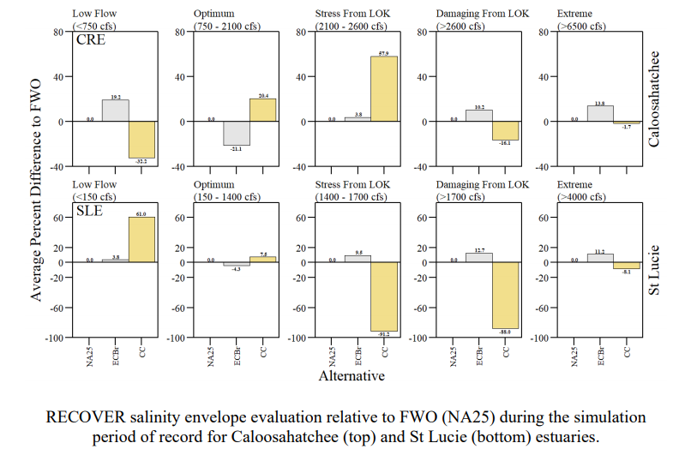
RECOVER Performance Metric

Slide 23
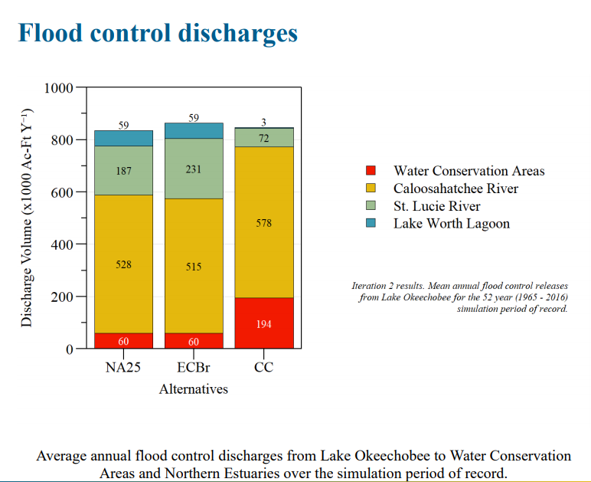

Slide 24
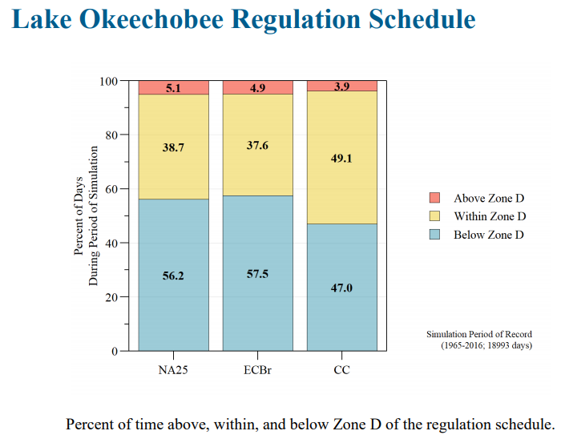

Slide 25
Modifications Needed to Optimize CC
Measure all discharges to Caloosahatchee Estuary at the Franklin Lock (S-79)
Cap regulatory discharges to CE in Zone D to maximum of 2,100 cfs at S-79— consistent with the ecological performance targets for the Caloosahatchee estuary
If flows are not capped at 2,100 in Zone D, equitably distribute flows across all outlets —south, east, & west—when conditions are wet
Allow for beneficial dry season releases to the Caloosahatchee & Everglades in all zones
Reduce total volume of water & nutrient loading to CE below NA25 (targeting stressful & damaging flow ranges)
Minimize or eliminate back flowing of nutrient-rich water from the Everglades Agricultural Area (EAA) & C-44 basins into the lake

Slide 26
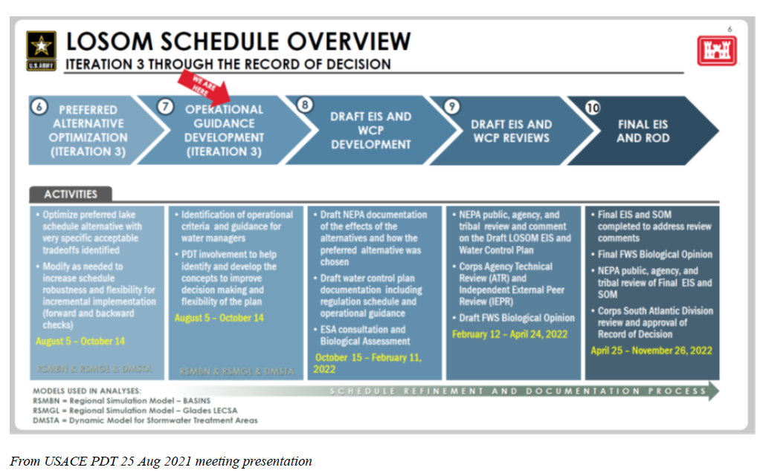
Next Steps in the LOSOM Process

Slide 27
Questions

